Slide 1


Titolo presentazione sottotitolo
GEE SCRUTINY, VISUALISATION, AND ANALYSIS OF THE USGS LANDSAT MISSIONS HISTORICAL DATA FOR AN AOI: CASE OF MOUNTAINOUS AND CLOUD-PRONE AREAS
Milano, XX mese 20XX
Executive Summary
Script Description
Use Case
1
Geoinformatics Project A.Y. 2022-2023
2
Daniel Alberto Aguirre Nieto
February 2024
3

Slide 2
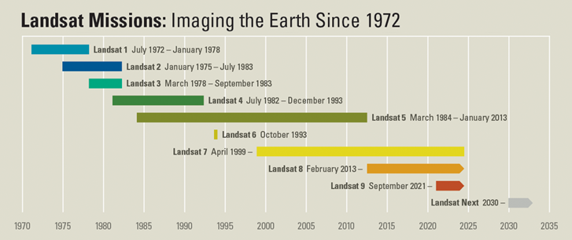
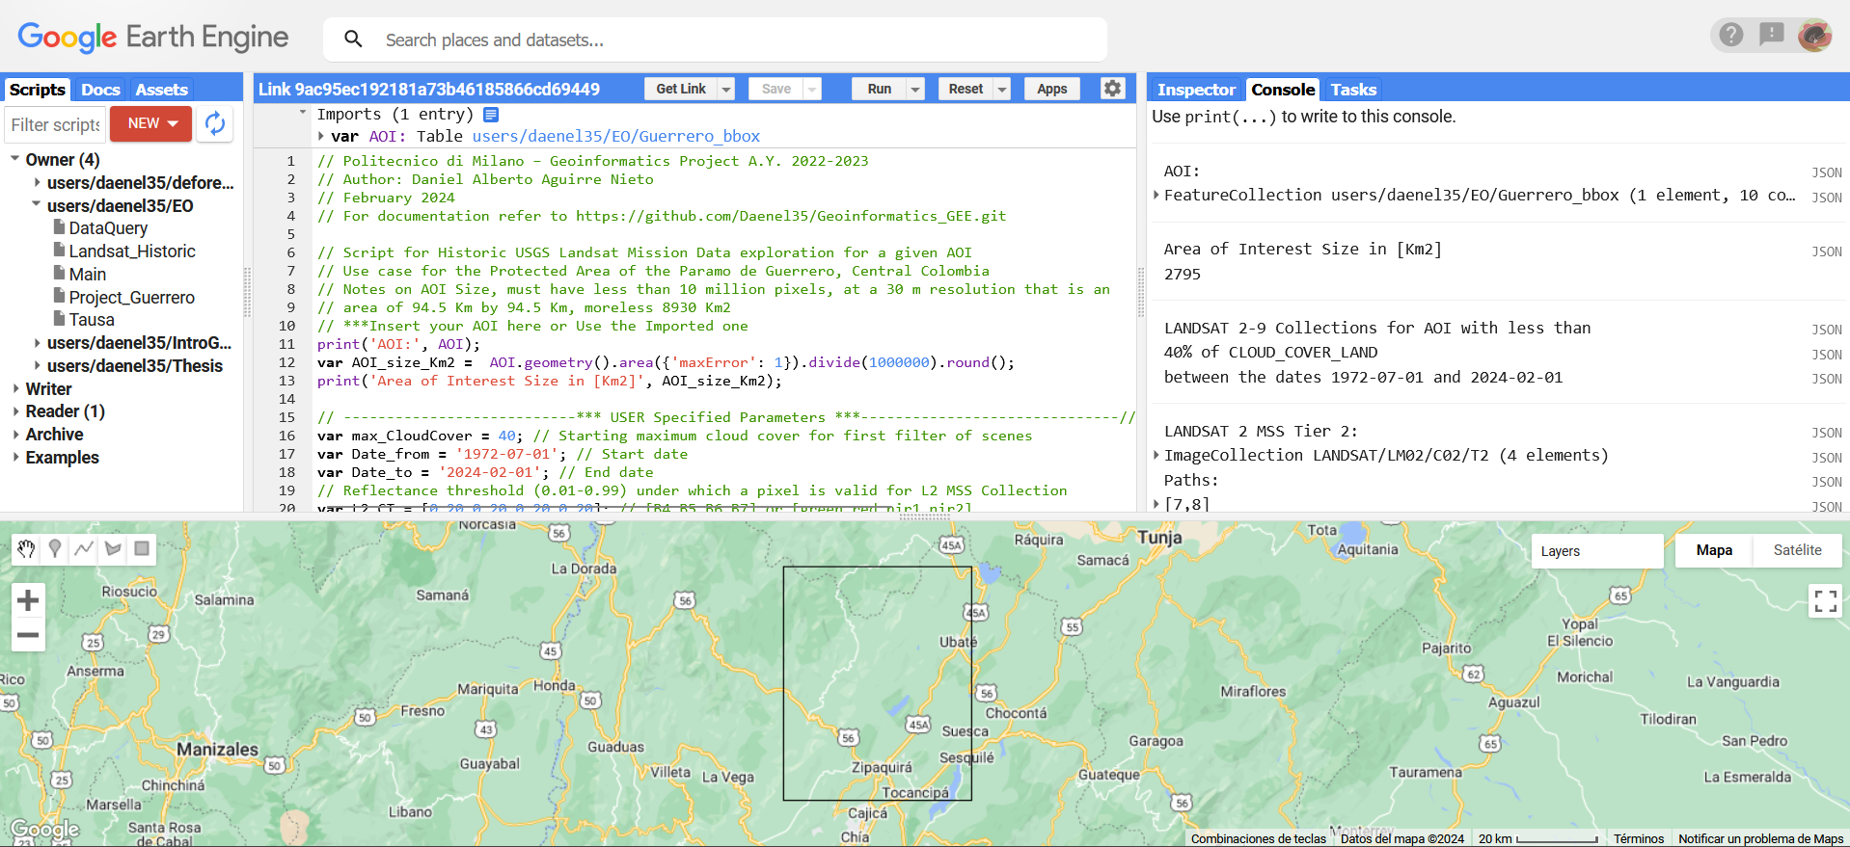
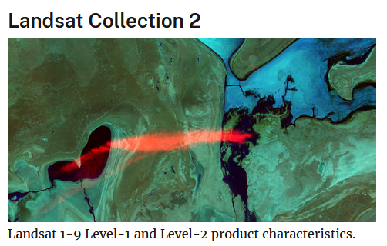

Executive Summary
1
PROJECT OVERVIEW
Development of a Tool as an open access script that allows the user to access, visualize, browse, and retrieve a customized view of the best available historic data for a given area.
Daniel Aguirre N. - danielalberto.aguirre@mail.polimi.it

Slide 3
2
Script Description
FUNCTIONAL OVERVIEW
General Operations:
Initial Filtering and Sorting
Processing
Final Filtering and Sorting
Visualization
STRUCTURE
Sequential Parts:
User Input
Functions
Processing
Final Visualization
CLOUD_COVER_LAND
VALID_AREA_PERCENTAGE
Image Property
Daniel Aguirre N. - danielalberto.aguirre@mail.polimi.it

Slide 4
Script Description
2
FUNCTIONS
TOA_from_Metadata_L[#]
Landsat 2, 4 , 5 MSS
DN to TOA_SR (Linear)
Cloud_Mask_MSS _L[#]
Landsat 2, 4 , 5 MSS
Thresholding (Clouds)
→Buffering (Edges/Haze)
→Buffer Translation (Cloud Shadow)
Get_Cloud_Mask_QA (QA_Pixel)
Get_Valid_px_Area_MSS (60 m Res.)
Get_Valid_px_Area (30 m Res.)
Get_Valid_px_Area_Perc
REFLECTANCE_MULT_BAND_#
REFLECTANCE_ADD_BAND_#
Landsat Scene
AOI
Cloud Threshold:
CT_L[#] =
[t1, t2, t3, t4] float 0-0,99
Pixel Buffer:
L[#]_Px_buffer int <1000
Shadow Distance:
L[#]_Shadow_dist int <9450
Minimum Valid Area Percentage:
min_validA_ L[#] float 0-99,9
New
VALID_AREA
New
VALID_AREA_PERCENTAGE
*Image Property
Daniel Aguirre N. - danielalberto.aguirre@mail.polimi.it

Slide 5
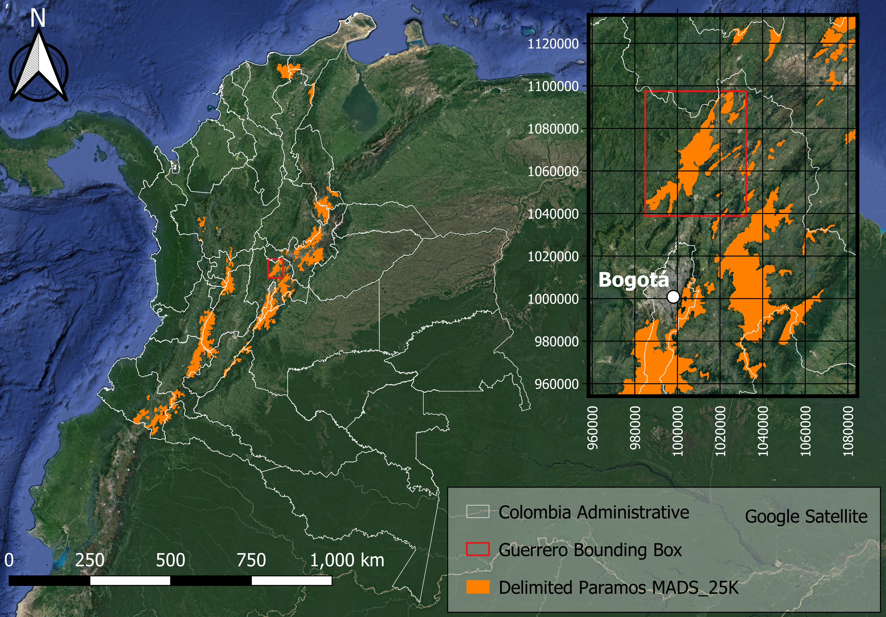
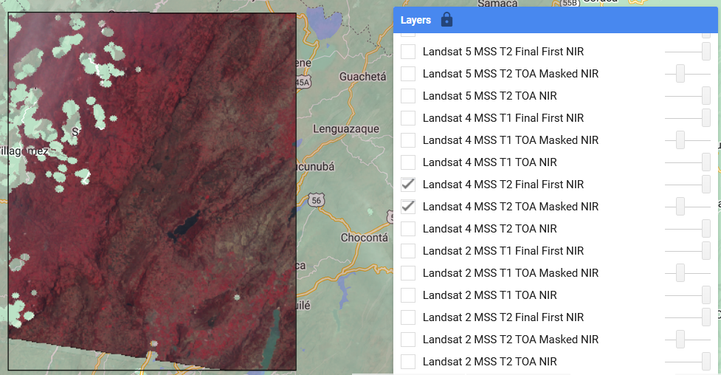
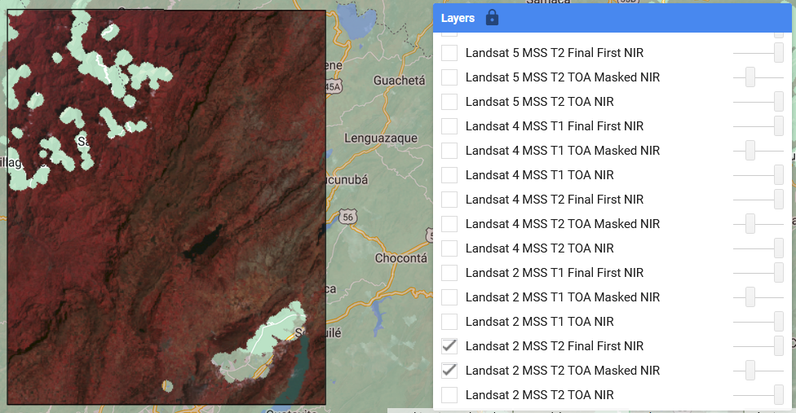
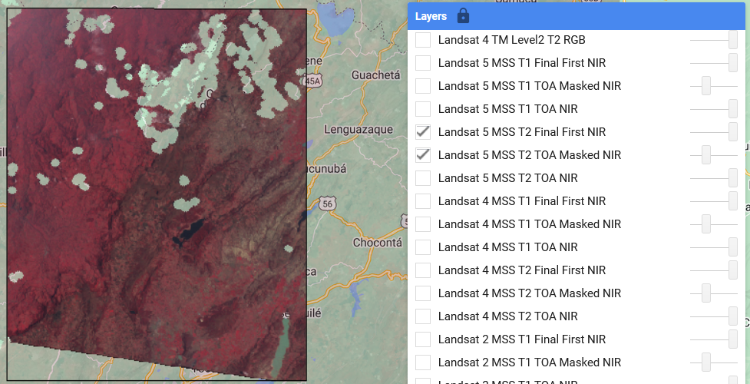
Use Case: Central Colombia
3
MSS Cloud Masking function best results (No T1):
L2 MSS T2 (1977-01-07) L4 MSS T2 (1988-03-22) L5 MSS T2 (1985-03-22)
- Threshold values tradeoff clouds vs. High reflecting surfaces (greenhouses)
- Buffer tradeoff vs. Valid Pixel
- Even cloud shadow masking vs. Parallax
CLOUD_COVER_LAND = 12
~88 % Valid
CLOUD_COVER_LAND = 4
~96 % Valid
CLOUD_COVER_LAND = 13
~87 % Valid
New
VALID_AREA_PERCENTAGE = 96,05
New
VALID_AREA_PERCENTAGE = 92,35
New
VALID_AREA_PERCENTAGE = 89,69
SCENE METADATA PROPERTY
VS.
AOI ESTIMATED PROPERTY
Daniel Aguirre N. - danielalberto.aguirre@mail.polimi.it

Slide 6
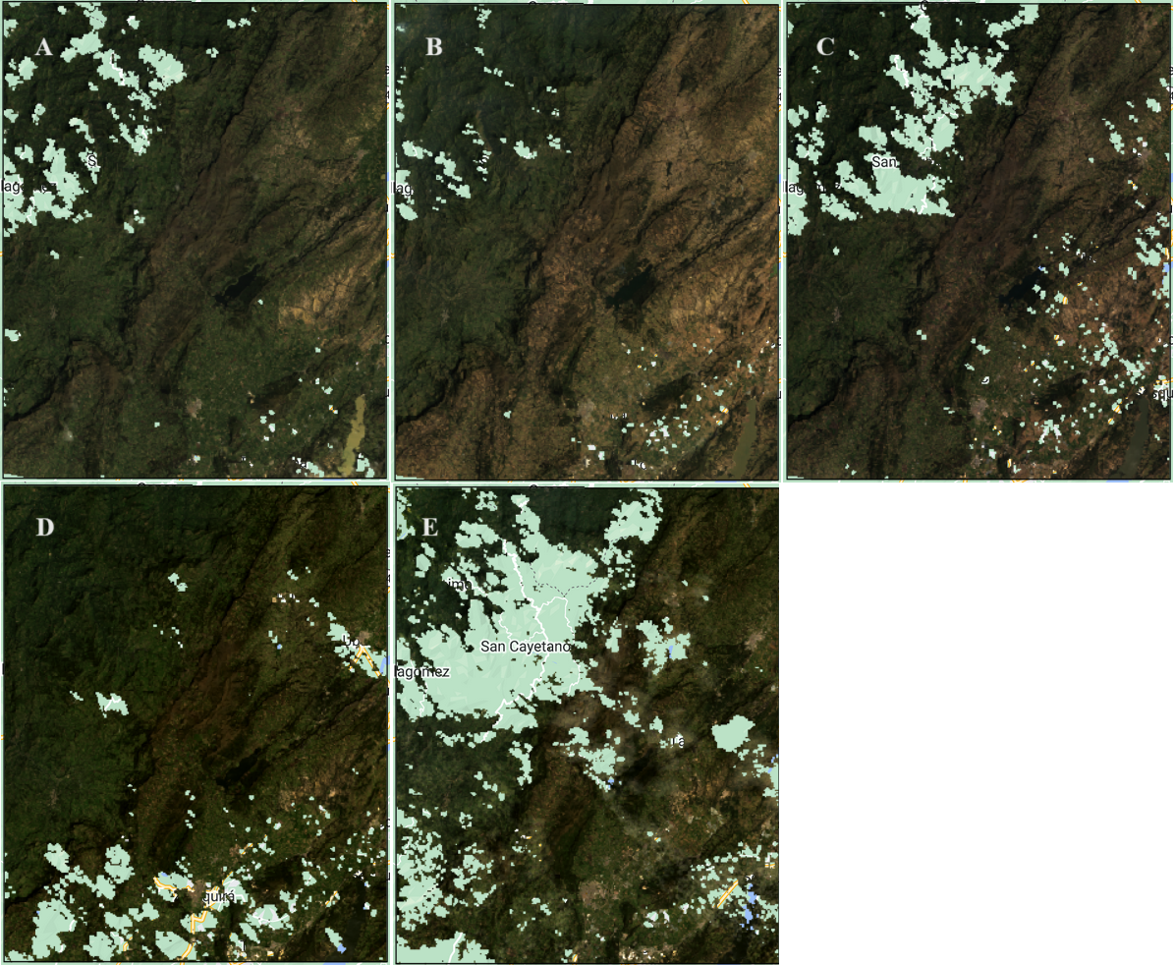
Use Case: Central Colombia
3
T1 Best results:
SCENE METADATA PROPERTY
VS.
AOI ESTIMATED PROPERTY
OBJECTIVE CRITERION
MORE ACCURATE RANKING
EFFICIENT DATA SCRUTINY
A
B
C
D
E
Daniel Aguirre N. - danielalberto.aguirre@mail.polimi.it

Slide 7
Use Case: Central Colombia
3
CONCLUSIONS
The project created a versatile tool and a more efficient way to scrutinize the highest available data quality datasets of the vast USGS Landsat Collection 2, to obtain the best available images when scouting for an AOI in a cloud-prone area.
The developed script retrieves the best imagery available (clearest images) through an objective criterion, namely the percentage of valid pixel (non-cloud) area within the AOI and display a comparable subset of T1 data as a GIF.
The use case of the script allowed for the successful retrieval of the best AOI imagery, suitable for time-series analysis in the Eastern Andes mountainous area of central Colombia. Throughout five decades of satellite passive remote sensing no cloud-free image on the AOI (~2795 Km²) could be obtained.
Daniel Aguirre N. - danielalberto.aguirre@mail.polimi.it

